Slide 1
FRAUD DETECTION
PRESENTED BY ,
F.RUFINA

Slide 2
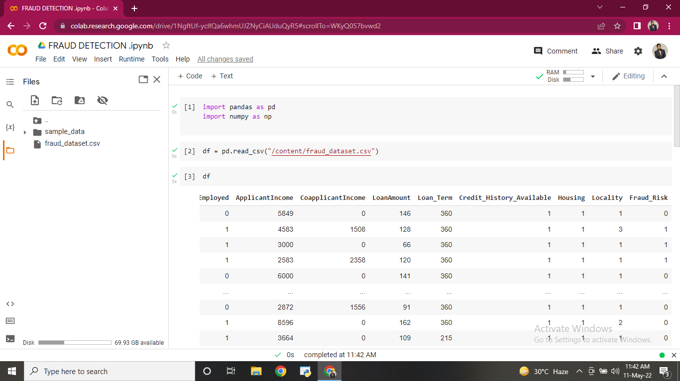

Slide 3
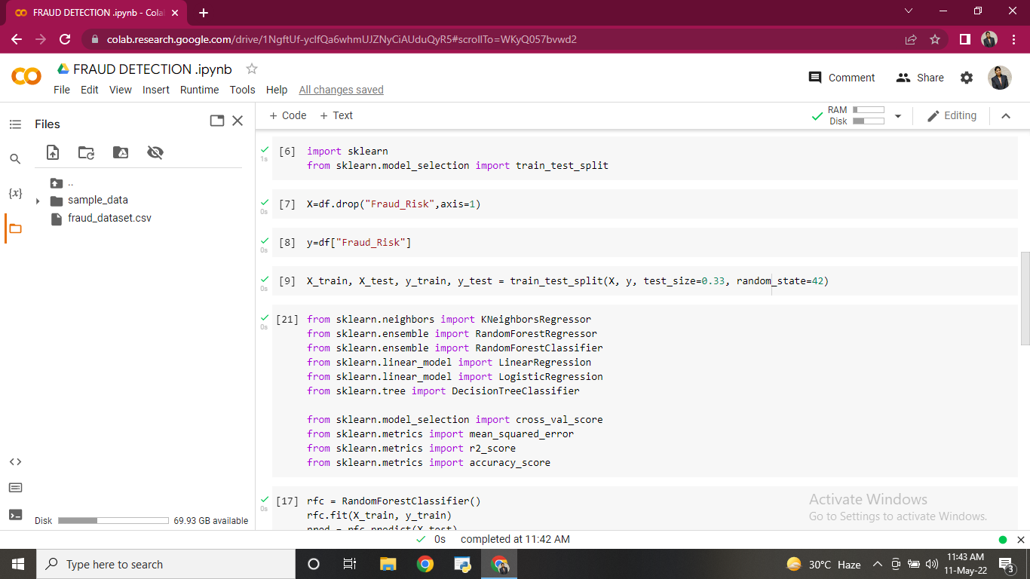

Slide 4
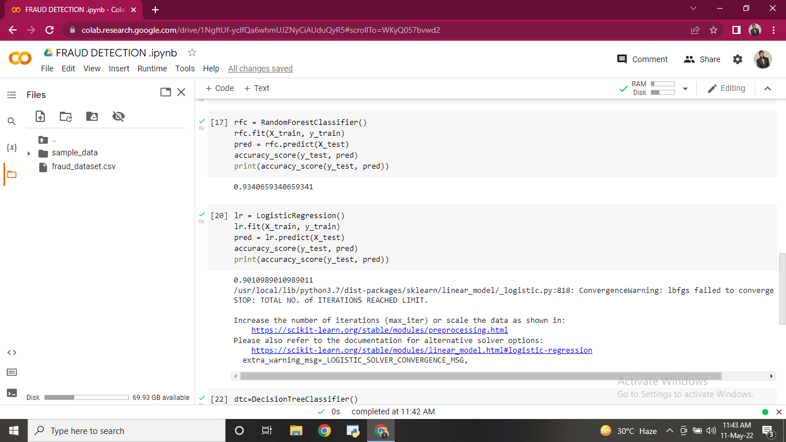

Slide 5
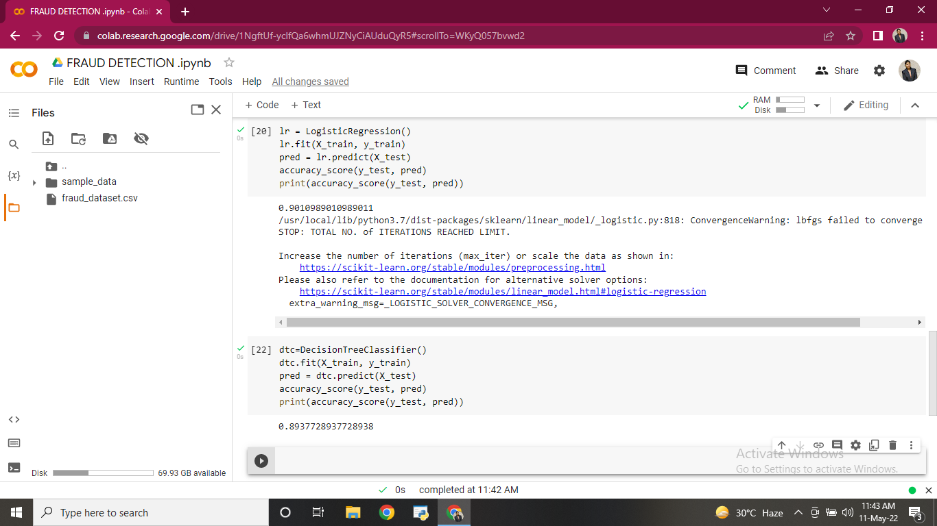

Slide 6
THANK YOU

